Slide 1
Book Selection Aids

Slide 13
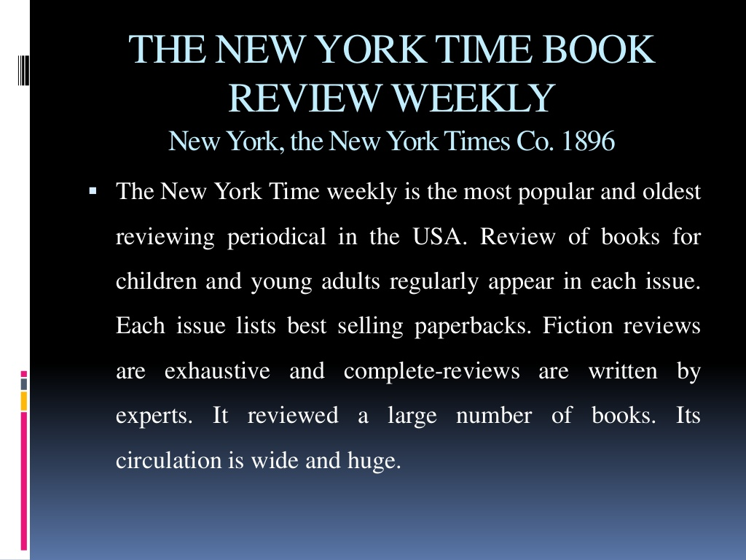

Slide 20
World Wide Web Book Selection Tools

Slide 21
Amazon.com Books Online
Amazon, is an American electronic commerce and cloud computing company, founded on July 5, 1994, by Jeff Bezos and based in Seattle, Washington. It is the largest Internet-based retailer in the world by total sales and market capitalization. Amazon.com started as an online bookstore, later diversifying to sell DVDs, CDs, Videos, MP3s, Software, video games, electronics, apparel, furniture, food, toys, and jewelry. Amazon also sells certain low-end products like USB cables under its in-house brand AmazonBasics.

Slide 22
Cont….
It is the most popular book selection site. This site allow customers to post online reviews Look up a book on Amazon.com and you can find story synopsis, reviews from several journals, and reviews by other people who’ve read the book and felt moved to talk about it.

Slide 23
Barnes and Noble Online Bookstore
The online version of the large chain bookstore. Like Amazon.com, it provides reviews from journals, but unlike Amazon it does not allow customers to post online reviews.
It contains over 6 million books for shipment within 24 hours and 4.5 million eBooks to download.

Slide 24
Bookwire
A good place to go if you’re looking for book or author information. Bookwire partners with several well-known journals including Library Journal and School Library Journal, both of which have online versions hosted by Bookwire

Slide 25
Publishers weekly
Publishers Weekly (PW) is an American weekly trade news magazine targeted at publishers, librarians, booksellers and literary agents. Published continuously since 1872. With 51 issues a year, the emphasis today is on book reviews. It contains reviews on books published by more than 6000 publishers.

Slide 26
Books in Print Database
Books in Print®, the leading bibliographic database listing more than 20 million titles (books currently in print, out-of-print books and forthcoming books) provides valuable resource for publishers, retailers and libraries in the process of book discovery and acquisition. Its web address is www.booksinprint.com

Slide 27
Google Books
Google Books, previously known as Google Book Search and Google Print, is a service from Google Inc. that searches the full text of books and magazines that Google has scanned, converted to text and stored in its digital database.Books are provided either by publishers and authors, through the Google Books Partner Program, or by Google's library partners, through the Library Project. This program was first started by Google in 2004 under the ame google print. Additionally, Google has partnered with a number of magazine publishers to digitize their archives.
As of October 2015, the number of scanned book titles was over 25 million. The web addres of this site is books.google.com

Slide 28
Kirkus
Kirkus Reviews (or Kirkus Media) is an American book review magazine founded in 1933 by Virginia Kirkus (1893–1980).^{[1]} The magazine is headquartered in New York City.^{[2]}
Kirkus Reviews, published on the first and 15th of each month, previews books prior to their publication. Kirkus reviews over 7,000 titles per year.^{[1][3]}
It is an excellent book selection tool for books on every subject.

Slide 29
Ulrich's Periodicals Directory
Ulrich's Periodicals Directory is the standard library directory and database providing information about popular and academic magazines, scientific journals, newspapers and other serial publications.
The print version has been published since 1932
The online version includes over 300,000 active and current periodicals.^{[3]}
Earlier published by R.R. Bowker. Now it is being published online and in print by ProQuest.^{[5]}

